Slide 1
Spring LEARN Session:
Refreshers & Reminders
HSC Financial services
Unrestricted Accounting
April 23, 2026

Slide 2
Account Codes Refresher

Slide 3
31F0 – Kitchen Supplies
COA Definition: Supplies such as bowls, pots, pans, cooking utensils etc. (Example: Mixing bowls used in the UNM child care facility kitchen)
Appropriate Use: This account code is appropriate ONLY for items purchased for an official kitchen.
Alternatives: Items such as plates, cups, napkins, stirrers, paper towels, small appliances etc. for use in departments should be coded to account code 37Y0.
Related Policy Guidance: Policy 4000, section 5.3 https://unmpolicy.policystat.com/policy/17085030/latest#autoid-da6m8

Slide 4
3860 – Bus Meals and Hospitality General
COA Definition 3860: All business-related food expenses purchased for guests while traveling, excluding meal expense incurred in the recruitment process.
Related Policy: Policy 4030, 12.1 - Travelers may be reimbursed for their own meals, or for non-UNM employees' meals as part of a business meal. Travelers may not be reimbursed for meals for other UNM employees.
Appropriate Use: Account code should only be used when expense is incurred 50+ miles from ABQ.
Alternatives: UNM employees attending a business meeting while traveling must pay for their own meals and request reimbursement via CR as a Per Diem amount (3820, 3800, 3840). Local business-related food expenses should post to account code 31A0 or 31B0.

Slide 5
3182 – Tools <$5001
COA Definition: Non-capital tools with a per item cost less than $5,001.
Appropriate Use: Purchase of tools for use by all individuals in the department.
Alternative: Tools purchased for specific individuals (e.g., loupes, stethoscopes) should post to account code 37Y0.

Slide 6
31N2 – Individual Safety Equipment
COA: Goggles, masks, steel-toed boots, etc.
Appropriate Use: Safety equipment for individuals that is required to perform their duties in a safe manner.
Alternative: Health oriented items for specific individuals (e.g., air purifier, special masks, ergonomic equipment) should post to account code 37Y0.
Related Guidance: Pcard prohibited

Slide 7
31S2 – Field Supplies
COA Definition: Supplies used in the field. (Examples: drill bits, picks, gloves)
Appropriate Use: Supplies for work in the field. These can be for ambulances or other vehicles used to serve the public or for training students and staff. (Examples: Medicine Bow (Emergency Medicine) and Internal Medicine’s program for those who are unhoused.
Alternatives: Food and water in the field either for staff and clients/patients should post to 31B0.
Related Policy Guidance: Policy 4000, section 5.3 https://unmpolicy.policystat.com/policy/17085030/latest#autoid-da6m8

Slide 8
General Expense Account Codes by Category
Supplies
  37Y0 – Supply costs that are considered F&A unallowable under OMB Circular A-21. Includes costs incurred for lobbying, selling/marketing, alumni, advertising/public relations, fund raising/development, and student activities. Also, supplies not for general use.
  37Z0 - Supply costs that cannot be classified in account codes 31xx
  Services
  69Y0 – Supply costs that are considered F&A unallowable under OMB Circular A-21. Includes costs incurred for lobbying, selling/marketing, alumni, advertising/public relations, fund raising/development, and student activities
  69Z0 – Includes the cost of professional services provided by an outside, non-campus source that cannot be classified in other service account codes

Slide 9
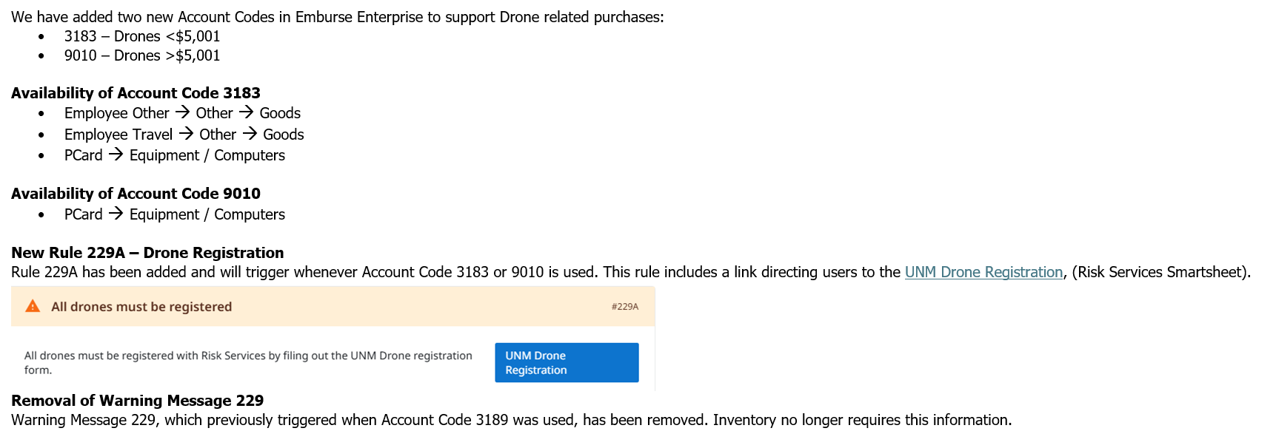
New Drone-Related Account Codes and Updated Rules in Emburse Enterprise

Slide 10
Account Code 3189-Non Capital equipment <$5,000
    Chrome River/Emburse Enterprise – When choosing 3189 account code, you should no longer get the warning message that asks for manufacturer details.
    No UNM asset tags for Computer Devices Under $5,000: These devices will not receive UNM property tags and will not be included in the University's annual physical inventories.
    Optional Tagging - Departments wishing to obtain a UNM tag for such devices may submit a request through the Smartsheet link provided below. Please ensure all required information is completed to facilitate the issuance of a tag.
    Computer tag request form -
    https://app.smartsheet.com/b/form/deb85c1548df440c931af33c63bf7e93
    Internal Tracking Responsibility: Departments are now responsible for tracking the acquisition, transfer, and checkout of these devices internally. This includes maintaining records of device assignments and any changes in location or custody.

Slide 11
Tax and Tariff Rules - LoboMart
The September Purchasing Newsletter announced the following new rules for LoboMart requisitions:
Include any applicable tax on a separate line, clearly labeled as “Tax.” Do not bundle tax into the unit price or shipping costs.
Include any applicable tariffs on a separate line, clearly labeled as “Tariff” or “Import Tariff.” Do not bundle tariffs into the unit price or shipping costs.
Step-by-step instructions for adding these separate lines (Create Requisition with Separate Tax/Shipping) can be found at purchase.unm.edu/department-information/lobomart-job-aids/index.html.

Slide 12
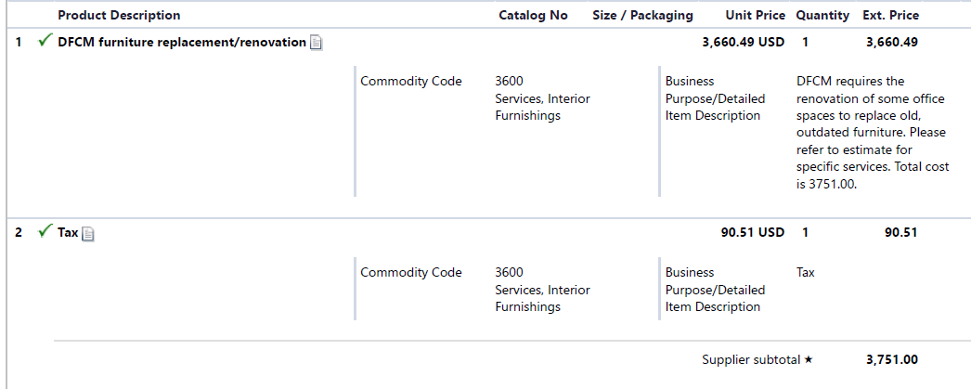
Tax and Tariff Rules - LoboMart

Slide 13
How To Prepare for Year-End
Clean up Department Indices
  Determine that spending rates are appropriate
  Ensure transactions look appropriate
Review Labor Distributions
  Ensure labor (names) hitting indices should be charged to that index
  Ensure % of labor is correct
Review Endowed and Non-endowed Indices
  Ensure foundation indices are not overspent (Spending indices cannot end in deficit)
Review Annual Purchase Orders and clean up Encumbrances
  Close out any old or unused purchase orders

Slide 14
Documentation Reminders for CR Travel Reimbursement Reports
Please attach one copy of the conference/meeting agenda to the home page of the report.
Please do not upload the same attachment more than once. Attach unique documents to the page for each line item. (Example: Uber receipt to the line item for ground transportation.)
Reference Pcard Report numbers for airfare, conference fees, and hotel in a “Comment” on the home page of the report.
When using the Business/Entertainment/Hospitality Meals mosaic, please list all attendees in the “Guests” section. Alternately, upload a CVS file with names and relationship to the University.
Submit one report for a single travel event.

Slide 15


QUESTIONS
“Your Partners in Clarity and Compliance”

